Slide 1
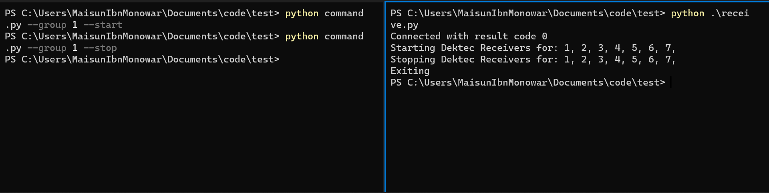
Operator side
Edge server side

